Slide 1
Auction System
Shrenik Dnyanesh Daga
Syracuse University
August 2019

Slide 2
Overview
The project consists of 3 packages:
1. AuctionSystem3:
ASP.Net core MVC app.
Website mainly for admin activities.
SQLServer for database.
2. AuctionUsers
WPF app with WEB API capabilities.
Seller/Bidder use.
3. DbManipulator
C# console app.
Runs forever.

Slide 3
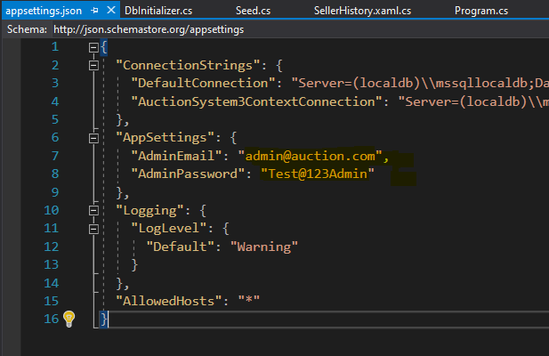
AuctionSystem3
Admin login:
View all the bids happened so far on all the products.
Delete any bid.
Admin account will be automatically created, details can be found in the appsettings.json file of AuctionSystem3.

Slide 4
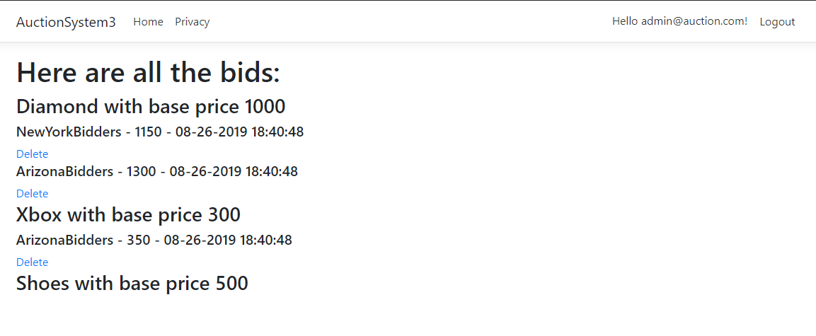
AuctionSystem3 (contd)

Slide 5
AuctionSystem3 (contd)
User login:
Register yourself as seller or bidder.
Receive an id to be used to login from the WPF app.
Please create a user account and register as either buyer or seller, receive a code and keep safe.

Slide 6
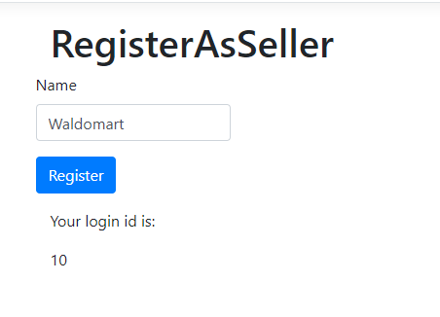
AuctionSystem3 (contd)
Use this login to access the features from WPF app

Slide 7
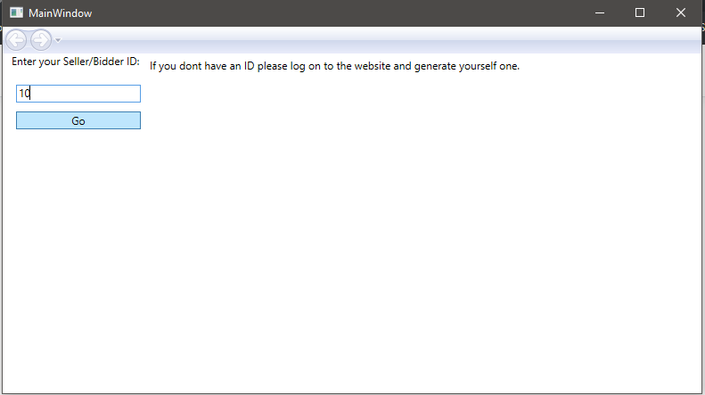
AuctionUsers
C# WPF application used to serve as user point for both seller and bidder.

Slide 8
AuctionUser (contd)
Seller
Use the code generated at website or use 10 for testing purposes.
Option to upload a product can be found.
Use either “painting” or “car” to test the upload part, as it corresponding images are already saved in the Pictures folder in bin/debug/Pictures.
Option to view history of products and their bids. Click on the pictures to see the bids in descending order on the right side

Slide 9
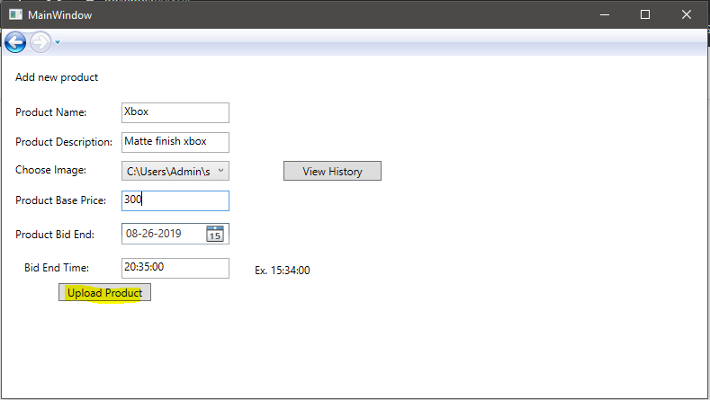
AuctionUsers (contd)

Slide 10
AuctionUser (contd)
Bidder
Use the code generated at website or use 11 for testing purposes.
All available products are displayed.
Select any one, to see its name reflect on the right side on the frame.
Enter the bid amount and click on Post Bid to post the bid. Bid will not be posted if the products bidding time expires before the request reached the server.

Slide 11
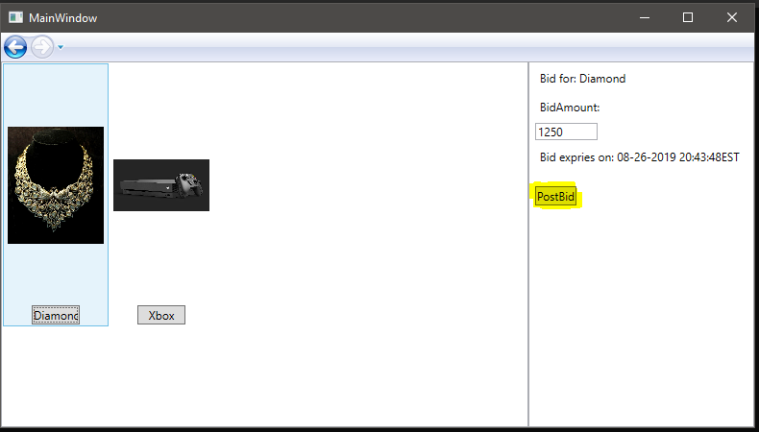
AuctionUsers (contd)

Slide 12
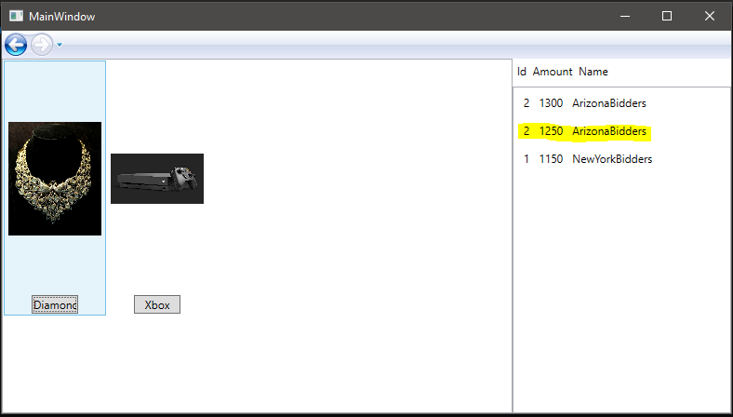
AuctionUser (contd)

Slide 13
DbManipulator
C# Console app
Only functionality is to poll every one minute to check the Db
Check for all the products and set “isActive” field of the product to false if the end bid time is due.
Loops in a while(true) block.
Seeded Data has 3 products which will end their bidding time after 2:00, 2:30 and 3:00 minutes respectively. Please check this console after 2 minutes of applying migrations and running the projects.

Slide 14
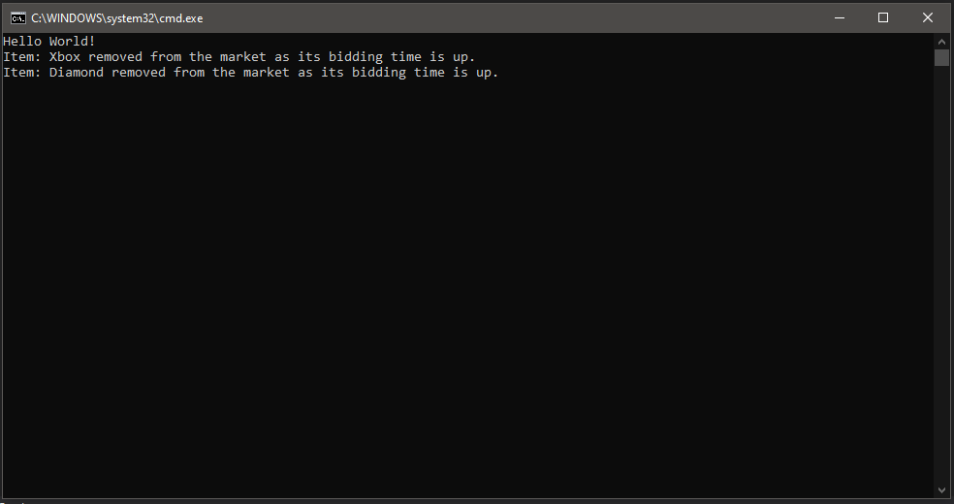
DbManipulator(contd)

Slide 15
Errors, Exceptions
Even if you enter the wrong id at WPF window, it wont crash.
All the products which have crossed the due date/time, wont be shown to the bidder to avoid wrong bids.
Using single DbContext hence, DBManipulator app does not update changes on the queried result, but on a list, avoiding SQL Exception for more than Sinlge Data Reader.
Admin roles like delete and viewbids are authorised for admin role only.

Slide 16
Future Scope and Possible changes
I could not integrate the email sending part into my project. Apologies for the inconvenience.
I also did not have time to add the update bid part, but I know how it can be done and I will definitely add that in the future.
Instead of displaying the due time for bidding, I would add a countdown on the bidder window.

Slide 17
Thank you
Shrenik Dnyanesh Daga
shrenikdaga@gmail.com
Syracuse University, NY, USA

